Slide 1

From Nand to Tetris
Building a Modern Computer from First Principles
Chapter 1
Boolean Logic
These slides support chapter 1 of the book
The Elements of Computing Systems
(1st and 2nd editions)
By Noam Nisan and Shimon Schocken
MIT Press

Slide 2
Usage Notice
You are welcome to use this presentation, or any part of it, in Nand to Tetris courses, or in other courses, as you see fit.
Usage is free provided that it supports instruction in educational, non-profit settings.
You can use the slides as-is, or modify them as needed.
We’ll appreciate it if you will credit Nand to Tetris somewhere, and put a reference to www.nand2tetris.org
Happy teaching!
Shimon Schocken / Noam Nisan

Slide 3
Chapter 1: Boolean logic
Theory
Basic concepts
Boolean algebra
Boolean functions
Nand
Practice
Logic gates
HDL
Hardware simulation
Multi-bit buses
Project 1
Introduction
Chips
Guidelines
Teaching note:
This chapter starts with a “Theory” primer. Some aspects of this background, like simplifying and synthesizing Boolean functions, are not required for the remainder of the course.
With that in mind, instructors can reduce, or expand, the “Theory” part of this lecture, as they see fit.

Slide 4
Chapter 1: Boolean logic
Theory
Basic concepts
Boolean algebra
Boolean functions
Nand
Practice
Logic gates
HDL
Hardware simulation
Multi-bit buses
Project 1
Introduction
Chips
Guidelines

Slide 5
Chapter 1: Boolean logic
Theory
Basic concepts
Boolean algebra
Boolean functions
Nand
Practice
Logic gates
HDL
Hardware simulation
Multi-bit buses
Project 1
Introduction
Chips
Guidelines

Slide 6

Boolean values

Slide 7

Boolean values

Slide 8
Boolean values

Slide 9
Boolean values

Slide 10
Boolean values

Slide 11
Boolean values

Slide 12
Boolean values
off
no
false
0
on
yes
true
1
Boolean / binary values: 0, 1
Boolean / binary variable: holds a 0, or a 1
George Boole
1815 - 1864

Slide 13
Boolean values
b₁
b₀
1 binary variable: 2 possible states

Slide 14
Boolean values
b₁
b₀
1 binary variable: 2 possible states
2 binary variables: 4 possible states

Slide 15
Boolean values
b₀
b₂
b₁
1 binary variable: 2 possible states
2 binary variables: 4 possible states
3 binary variables: 8 possible states

Slide 16
Boolean values
...
b₂
b₁
b₀
1 binary variable: 2 possible states
2 binary variables: 4 possible states
3 binary variables: 8 possible states
...

Slide 17
Boolean values
...
b₂
b₁
b₀
1 binary variable: 2 possible states
2 binary variables: 4 possible states
3 binary variables: 8 possible states
...
Question: How many different states can be represented by N binary variables?

Slide 18
Boolean values
...
b₂
b₁
b₀
1 binary variable: 2 possible states
2 binary variables: 4 possible states
3 binary variables: 8 possible states
...
Question: How many different states can be represented by N binary variables?
Answer: 2^{N}

Slide 19
Boolean functions
x | y | f
0 | 0 | 0
0 | 1 | 0
1 | 0 | 0
1 | 1 | 1

Slide 20
Boolean functions
x | y | f
0 | 0 | 0
0 | 1 | 0
1 | 0 | 0
1 | 1 | 1

Slide 21
Boolean functions
x
x | y | f
0 | 0 | 0
0 | 1 | 0
1 | 0 | 0
1 | 1 | 1
f(x,y)
y
f
1 when x == 1 and y == 1
0 otherwise
f(x,y) =

Slide 22
Boolean functions
x
x | y | And
0 | 0 | 0
0 | 1 | 0
1 | 0 | 0
1 | 1 | 1
And(x,y)
y
And
1 when x == 1 and y == 1
0 otherwise
And(x,y) =
Boolean function (like And(x,y)):
A function that operates on boolean variables, and returns a boolean value.
Boolean operator (like x And y):
A simple boolean function that operates on a few boolean variables, called operands.

Slide 23
Boolean functions
x And y
x | y | And
0 | 0 | 0
0 | 1 | 0
1 | 0 | 0
1 | 1 | 1

Slide 24
Boolean functions
x And y
x Or y
x | y | And
0 | 0 | 0
0 | 1 | 0
1 | 0 | 0
1 | 1 | 1
x | y | Or
0 | 0 | 0
0 | 1 | 1
1 | 0 | 1
1 | 1 | 1

Slide 25
Boolean functions
x And y
x Or y
Not(x)
x | y | And
0 | 0 | 0
0 | 1 | 0
1 | 0 | 0
1 | 1 | 1
x | y | Or
0 | 0 | 0
0 | 1 | 1
1 | 0 | 1
1 | 1 | 1
x | Not
0 | 1
1 | 0

Slide 26
Boolean functions
x And y
x Or y
Not(x)
x | y | And
0 | 0 | 0
0 | 1 | 0
1 | 0 | 0
1 | 1 | 1
x | y | Or
0 | 0 | 0
0 | 1 | 1
1 | 0 | 1
1 | 1 | 1
x | Not
0 | 1
1 | 0
x Nand y
x | y | Nand
0 | 0 | 1
0 | 1 | 1
1 | 0 | 1
1 | 1 | 0

Slide 27
Boolean functions
x And y
x Or y
Not(x)
x | y | And
0 | 0 | 0
0 | 1 | 0
1 | 0 | 0
1 | 1 | 1
x | y | Or
0 | 0 | 0
0 | 1 | 1
1 | 0 | 1
1 | 1 | 1
x | Not
0 | 1
1 | 0
x Nand y
x Xor y
x | y | Nand
0 | 0 | 1
0 | 1 | 1
1 | 0 | 1
1 | 1 | 0
x | y | Xor
0 | 0 | 0
0 | 1 | 1
1 | 0 | 1
1 | 1 | 0

Slide 28
Boolean functions
x And y
x Or y
Not(x)
x | y | And
0 | 0 | 0
0 | 1 | 0
1 | 0 | 0
1 | 1 | 1
x | y | Or
0 | 0 | 0
0 | 1 | 1
1 | 0 | 1
1 | 1 | 1
x | Not
0 | 1
1 | 0
x Nand y
x Xor y
x f y
x | y | Nand
0 | 0 | 1
0 | 1 | 1
1 | 0 | 1
1 | 1 | 0
x | y | Xor
0 | 0 | 0
0 | 1 | 1
1 | 0 | 1
1 | 1 | 0
x | y | f
0 | 0 | v₁
0 | 1 | v₂
1 | 0 | v₃
1 | 1 | v₄
...

Slide 29
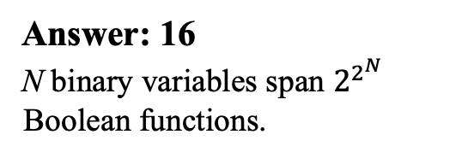
Boolean functions
x And y
x Or y
Question:
How many Boolean functions x f y exist over two binary (2-valued) variables?
x | y | And
0 | 0 | 0
0 | 1 | 0
1 | 0 | 0
1 | 1 | 1
x | y | Or
0 | 0 | 0
0 | 1 | 1
1 | 0 | 1
1 | 1 | 1
Answer: 16
N binary variables span $2^{2^{N}}$ Boolean functions.
x Nand y
x Xor y
x f y
x | y | Nand
0 | 0 | 1
0 | 1 | 1
1 | 0 | 1
1 | 1 | 0
x | y | Xor
0 | 0 | 0
0 | 1 | 1
1 | 0 | 1
1 | 1 | 0
x | y | f
0 | 0 | v₁
0 | 1 | v₂
1 | 0 | v₃
1 | 1 | v₄
...

Slide 30
Boolean functions
x And y
x Or y
Not(x)
x | y | And
0 | 0 | 0
0 | 1 | 0
1 | 0 | 0
1 | 1 | 1
x | y | Or
0 | 0 | 0
0 | 1 | 1
1 | 0 | 1
1 | 1 | 1
y | Not
0 | 1
1 | 0
Boolean function evaluation (example):

Slide 31
Boolean functions
x And y
x Or y
Not(x)
x | y | And
0 | 0 | 0
0 | 1 | 0
1 | 0 | 0
1 | 1 | 1
x | y | Or
0 | 0 | 0
0 | 1 | 1
1 | 0 | 1
1 | 1 | 1
y | Not
0 | 1
1 | 0
Boolean function evaluation (example):
Not(x Or (y And z))
Evaluate this function for, say,
x = 0, y = 1, z = 1
Not(0 Or (1 And 1)) =
Not(0 Or 1) =
Not(1) =
0

Slide 32

Chapter 1: Boolean logic
Theory
Basic concepts
Boolean algebra
Boolean functions
Nand
Practice
Logic gates
HDL
Hardware simulation
Multi-bit buses
Project 1
Introduction
Chips
Guidelines

Slide 33
Some Boolean identities
Commutative: x And y = y And x
x Or y = y Or x
Associative: x And (y And z) = (x And y) And z
x Or (y Or z) = (x Or y) Or z
Distributive: x And (y Or z) = (x And y) Or (x And z)
x Or (y And z)) = (x Or y) And (x Or z)
De Morgan: Not(x And y) = Not(x) Or Not(y)
Not(x Or y) = Not(x) And Not(y)
Idempotent: x And x = x
x Or x = x
Double negation: Not(Not(x)) = x

Slide 34
Some Boolean identities
Commutative: x And y = y And x
x Or y = y Or x
Associative: x And (y And z) = (x And y) And z
x Or (y Or z) = (x Or y) Or z
Distributive: x And (y Or z) = (x And y) Or (x And z)
x Or (y And z)) = (x Or y) And (x Or z)
De Morgan: Not(x And y) = Not(x) Or Not(y)
Not(x Or y) = Not(x) And Not(y)
Idempotent: x And x = x
x Or x = x
Double negation: Not(Not(x)) = x
All these identities can be easily proved from the function definitions of And, Or, Not
For example, let’s prove this identity

Slide 35
Boolean algebra
Prove
Not(x And y) = Not(x) Or Not(y)

Slide 36
Boolean algebra
Prove
Not(x And y) = Not(x) Or Not(y)
f(x,y) = Not(x And y)
g(x,y) = Not(x) Or Not(y)
x | y | f
0 | 0
0 | 1
1 | 0
1 | 1
x | y | g
0 | 0
0 | 1
1 | 0
1 | 1
Proof: Fill in the right column in both truth tables.
If f = g, the identity is proved.

Slide 37
Boolean algebra
Prove
Not(x And y) = Not(x) Or Not(y)
f(x,y) = Not(x And y)
g(x,y) = Not(x) Or Not(y)
x | y | f
0 | 0 | 1
0 | 1 | 1
1 | 0 | 1
1 | 1 | 0
x | y | g
0 | 0 | 1
0 | 1 | 1
1 | 0 | 1
1 | 1 | 0
Proof: Fill in the right column in both truth tables.
If f = g, the identity is proved.

Slide 38
Boolean algebra
Commutative: x And y = y And x
x Or y = y Or x
Associative: x And (y And z) = (x And y) And z
x Or (y Or z) = (x Or y) Or z
Distributive: x And (y Or z) = (x And y) Or (x And z)
x Or (y And z)) = (x Or y) And (x Or z)
De Morgan: Not(x And y) = Not(x) Or Not(y)
Not(x Or y) = Not(x) And Not(y)
Idempotent: x And x = x
x Or x = x
Double negation: Not(Not(x)) = x
Substitution:
In any such identity, x and y can be substituted with any boolean function
Substitution examples:
Not(Not(a)) = a
Not(Not(u Or v)) = u Or v
Etc.

Slide 39
Boolean algebra
Commutative: x And y = y And x
x Or y = y Or x
Associative: x And (y And z) = (x And y) And z
x Or (y Or z) = (x Or y) Or z
Distributive: x And (y Or z) = (x And y) Or (x And z)
x Or (y And z)) = (x Or y) And (x Or z)
De Morgan: Not(x And y) = Not(x) Or Not(y)
Not(x Or y) = Not(x) And Not(y)
Idempotent: x And x = x
x Or x = x
Double negation: Not(Not(x)) = x

Slide 40
Boolean algebra
Commutative: x And y = y And x
x Or y = y Or x
Associative: x And (y And z) = (x And y) And z
x Or (y Or z) = (x Or y) Or z
Distributive: x And (y Or z) = (x And y) Or (x And z)
x Or (y And z)) = (x Or y) And (x Or z)
De Morgan: Not(x And y) = Not(x) Or Not(y)
Not(x Or y) = Not(x) And Not(y)
Idempotent: x And x = x
x Or x = x
Double negation: Not(Not(x)) = x
Task: Simplify this function (example):
Not(Not(x) And Not(x Or y))

Slide 41
Boolean algebra
Commutative: x And y = y And x
x Or y = y Or x
Associative: x And (y And z) = (x And y) And z
x Or (y Or z) = (x Or y) Or z
Distributive: x And (y Or z) = (x And y) Or (x And z)
x Or (y And z)) = (x Or y) And (x Or z)
De Morgan: Not(x And y) = Not(x) Or Not(y)
Not(x Or y) = Not(x) And Not(y)
Idempotent: x And x = x
x Or x = x
Double negation: Not(Not(x)) = x
Task: Simplify this function (example):
Not(Not(x) And Not(x Or y)) =
Not(Not(x) And (Not(x) And Not(y)))
By De Morgan’s rule:

Slide 42
Boolean algebra
Commutative: x And y = y And x
x Or y = y Or x
Associative: x And (y And z) = (x And y) And z
x Or (y Or z) = (x Or y) Or z
Distributive: x And (y Or z) = (x And y) Or (x And z)
x Or (y And z)) = (x Or y) And (x Or z)
De Morgan: Not(x And y) = Not(x) Or Not(y)
Not(x Or y) = Not(x) And Not(y)
Idempotent: x And x = x
x Or x = x
Double negation: Not(Not(x)) = x
Task: Simplify this function (example):
Not(Not(x) And Not(x Or y)) =
Not(Not(x) And (Not(x) And Not(y))) =
Not((Not(x) And Not(x)) And Not(y)) =
By De Morgan’s rule:
By the associative rule:

Slide 43
Boolean algebra
Commutative: x And y = y And x
x Or y = y Or x
Associative: x And (y And z) = (x And y) And z
x Or (y Or z) = (x Or y) Or z
Distributive: x And (y Or z) = (x And y) Or (x And z)
x Or (y And z)) = (x Or y) And (x Or z)
De Morgan: Not(x And y) = Not(x) Or Not(y)
Not(x Or y) = Not(x) And Not(y)
Idempotent: x And x = x
x Or x = x
Double negation: Not(Not(x)) = x
Task: Simplify this function (example):
Not(Not(x) And Not(x Or y)) =
Not(Not(x) And (Not(x) And Not(y))) =
Not((Not(x) And Not(x)) And Not(y)) =
Not(Not(x) And Not(y))
By De Morgan’s rule:
By the associative rule:
By the idempotent rule:

Slide 44
Boolean algebra
Commutative: x And y = y And x
x Or y = y Or x
Associative: x And (y And z) = (x And y) And z
x Or (y Or z) = (x Or y) Or z
Distributive: x And (y Or z) = (x And y) Or (x And z)
x Or (y And z)) = (x Or y) And (x Or z)
De Morgan: Not(x And y) = Not(x) Or Not(y)
Not(x Or y) = Not(x) And Not(y)
Idempotent: x And x = x
x Or x = x
Double negation: Not(Not(x)) = x
Task: Simplify this function (example):
Not(Not(x) And Not(x Or y)) =
Not(Not(x) And (Not(x) And Not(y))) =
Not((Not(x) And Not(x)) And Not(y)) =
Not(Not(x) And Not(y)) =
Not(Not(x Or y))
By De Morgan’s rule:
By the associative rule:
By the idempotent rule:
By De Morgan’s rule:

Slide 45
Boolean algebra
Commutative: x And y = y And x
x Or y = y Or x
Associative: x And (y And z) = (x And y) And z
x Or (y Or z) = (x Or y) Or z
Distributive: x And (y Or z) = (x And y) Or (x And z)
x Or (y And z)) = (x Or y) And (x Or z)
De Morgan: Not(x And y) = Not(x) Or Not(y)
Not(x Or y) = Not(x) And Not(y)
Idempotent: x And x = x
x Or x = x
Double negation: Not(Not(x)) = x
Task: Simplify this function (example):
Not(Not(x) And Not(x Or y)) =
Not(Not(x) And (Not(x) And Not(y))) =
Not((Not(x) And Not(x)) And Not(y)) =
Not(Not(x) And Not(y)) =
Not(Not(x Or y)) =
x Or y
By De Morgan’s rule:
By the associative rule:
By the idempotent rule:
By De Morgan’s rule:
By double negation:

Slide 46
Boolean algebra
Task: Simplify this function (example):
Not(Not(x) And Not(x Or y)) =
Not(Not(x) And (Not(x) And Not(y))) =
Not((Not(x) And Not(x)) And Not(y)) =
Not(Not(x) And Not(y)) =
Not(Not(x Or y)) =
x Or y
Observations about simplifying Boolean functions:
Can lead to significant optimization
Based on intuition, experience, and luck
Can be assisted by some tools
But, in general: NP-hard.
By De Morgan’s rule:
By the associative rule:
By the idempotent rule:
By De Morgan’s rule:
By double negation:

Slide 47
Boolean algebra
Another example: Prove that
Commutative: (x And y) = (y And x)
(x Or y) = (y Or x)
Associative: (x And (y And z)) = ((x And y) And z)
(x Or (y Or z)) = ((x Or y) Or z)
Distributive: (x And (y Or z)) = (x And y) Or (x And z)
(x Or (y And z)) = (x Or y) And (x Or z)
De Morgan: Not(x And y) = Not(x) Or Not(y)
Not(x Or y) = Not(x) And Not(y)
Idempotent: (x And x) = x
(x Or x) = x
Double negation: Not(Not(x)) = x
x Or y = Not(Not(x) And Not(y))

Slide 48
Boolean algebra
Another example: Prove that
Commutative: (x And y) = (y And x)
(x Or y) = (y Or x)
Associative: (x And (y And z)) = ((x And y) And z)
(x Or (y Or z)) = ((x Or y) Or z)
Distributive: (x And (y Or z)) = (x And y) Or (x And z)
(x Or (y And z)) = (x Or y) And (x Or z)
De Morgan: Not(x And y) = Not(x) Or Not(y)
Not(x Or y) = Not(x) And Not(y)
Idempotent: (x And x) = x
(x Or x) = x
Double negation: Not(Not(x)) = x
x Or y = Not(Not(x) And Not(y))
De Morgan:
Not(x Or y) = Not(x) And Not(y)
Negate both sides:
Not(Not(x Or y)) = Not(Not(x) And Not(y))
By double negation:
x Or y = Not(Not(x) And Not(y))
Implication
We don’t really “need” Or
We will soon revisit this reduction

Slide 49
Chapter 1: Boolean logic
Theory
Basic concepts
Boolean algebra
Boolean functions
Nand
Practice
Logic gates
HDL
Hardware simulation
Multi-bit buses
Project 1
Introduction
Chips
Guidelines

Slide 50
Boolean function
Formula (example)
f(x, y, z) = (x And (Not(y) Or z)) And y
Truth table
x | y | z | f
0 | 0 | 0 | 0
0 | 0 | 1 | 1
0 | 1 | 0 | 0
0 | 1 | 1 | 1
1 | 0 | 0 | 0
1 | 0 | 1 | 0
1 | 1 | 0 | 1
1 | 1 | 1 | 1
A Boolean function can be expressed using a formula, or a truth table
The two representations are equivalent
Question: Can we construct each representation from the other one?

Slide 51
Formula truth table
Formula
f(x, y, z) = (x And (Not(y) Or z)) And y

Slide 52
Formula truth table
Formula
f(x, y, z) = (x And (Not(y) Or z)) And y
Truth table
x | y | z | f
0 | 0 | 0
0 | 0 | 1
0 | 1 | 0
0 | 1 | 1
1 | 0 | 0
1 | 0 | 1
1 | 1 | 0
1 | 1 | 1

Slide 53
Formula truth table
Formula
f(x, y, z) = (x And (Not(y) Or z)) And y
Truth table
x | y | z | f
0 | 0 | 0 | 0
0 | 0 | 1 | 0
0 | 1 | 0
0 | 1 | 1
1 | 0 | 0 | 0
1 | 0 | 1 | 0
1 | 1 | 0
1 | 1 | 1
When y = 0, f must be 0
f

Slide 54
Formula truth table
Formula
f(x, y, z) = (x And (Not(y) Or z)) And y
Truth table
x | y | z | f
0 | 0 | 0 | 0
0 | 0 | 1 | 0
0 | 1 | 0 | 0
0 | 1 | 1 | 0
1 | 0 | 0 | 0
1 | 0 | 1 | 0
1 | 1 | 0
1 | 1 | 1
When y = 0, f must be 0
When x = 0, f must be 0
f

Slide 55
Formula truth table
Formula
f(x, y, z) = (x And (Not(y) Or z)) And y
Truth table
x | y | z | f
0 | 0 | 0 | 0
0 | 0 | 1 | 0
0 | 1 | 0 | 0
0 | 1 | 1 | 0
1 | 0 | 0 | 0
1 | 0 | 1 | 0
1 | 1 | 0 | 1
1 | 1 | 1 | 1
When y = 0, f must be 0
When x = 0, f must be 0
f
(1 And (Not(1) Or 0)) And 1 = 1
(1 And (Not(1) Or 1)) And 1 = 1

Slide 56
Formula truth table
Formula
f(x, y, z) = (x And (Not(y) Or z)) And y
?
Truth table
x | y | z | f
0 | 0 | 0 | 0
0 | 0 | 1 | 0
0 | 1 | 0 | 0
0 | 1 | 1 | 0
1 | 0 | 0 | 0
1 | 0 | 1 | 0
1 | 1 | 0 | 1
1 | 1 | 1 | 1
Lemma
Given a Boolean function expressed as a formula, we can always construct from it its truth table.
Proof: Evaluate the function over all the possible values of its variables (which is the definition of a truth table)

Slide 57
Boolean function synthesis: Truth table formula
Formula
f(x, y, z) = (x And (Not(y) Or z)) And y
?
?
Truth table
x | y | z | f
0 | 0 | 0 | 0
0 | 0 | 1 | 0
0 | 1 | 0 | 0
0 | 1 | 1 | 0
1 | 0 | 0 | 0
1 | 0 | 1 | 0
1 | 1 | 0 | 1
1 | 1 | 1 | 1
Can we also go the other way around, for any given truth table?

Slide 58
Boolean function synthesis: Truth table formula
x | y | z | f
0 | 0 | 0 | 1
0 | 0 | 1 | 0
0 | 1 | 0 | 1
0 | 1 | 1 | 0
1 | 0 | 0 | 1
1 | 0 | 1 | 0
1 | 1 | 0 | 0
1 | 1 | 1 | 0
Goal: Synthesize a formula which is equivalent to this truth table

Slide 59
Boolean function synthesis
x | y | z | f
0 | 0 | 0 | 1
0 | 0 | 1 | 0
0 | 1 | 0 | 1
0 | 1 | 1 | 0
1 | 0 | 0 | 1
1 | 0 | 1 | 0
1 | 1 | 0 | 0
1 | 1 | 1 | 0
Focus on the rows where f = 1

Slide 60
Boolean function synthesis
x | y | z | f | f₁
0 | 0 | 0 | 1 | 1
0 | 0 | 1 | 0 | 0
0 | 1 | 0 | 1 | 0
0 | 1 | 1 | 0 | 0
1 | 0 | 0 | 1 | 0
1 | 0 | 1 | 0 | 0
1 | 1 | 0 | 0 | 0
1 | 1 | 1 | 0 | 0
Not(x) And Not(y) And Not(z)
Focus on the rows where f = 1
For each such row i, define a function f_{i} which equals 1 in row i and 0 elsewhere. Define f_{i} to be a conjunction of all of f’s variables or their negations, as the variable is 1 or 0 in the i’th row

Slide 61
Boolean function synthesis
x | y | z | f | f₁ | f₃
0 | 0 | 0 | 1 | 1 | 0
0 | 0 | 1 | 0 | 0 | 0
0 | 1 | 0 | 1 | 0 | 1
0 | 1 | 1 | 0 | 0 | 0
1 | 0 | 0 | 1 | 0 | 0
1 | 0 | 1 | 0 | 0 | 0
1 | 1 | 0 | 0 | 0 | 0
1 | 1 | 1 | 0 | 0 | 0
Not(x) And Not(y) And Not(z)
Not(x) And y And Not(z)
Focus on the rows where f = 1
For each such row i, define a function f_{i} which equals 1 in row i and 0 elsewhere. Define f_{i} to be a conjunction of all of f’s variables or their negations, as the variable is 1 or 0 in the i’th row

Slide 62
Boolean function synthesis
x | y | z | f | f₁ | f₃ | f₅
0 | 0 | 0 | 1 | 1 | 0 | 0
0 | 0 | 1 | 0 | 0 | 0 | 0
0 | 1 | 0 | 1 | 0 | 1 | 0
0 | 1 | 1 | 0 | 0 | 0 | 0
1 | 0 | 0 | 1 | 0 | 0 | 1
1 | 0 | 1 | 0 | 0 | 0 | 0
1 | 1 | 0 | 0 | 0 | 0 | 0
1 | 1 | 1 | 0 | 0 | 0 | 0
Not(x) And Not(y) And Not(z)
Not(x) And y And Not(z)
x And Not(y) And Not(z)
Focus on the rows where f = 1
For each such row i, define a function f_{i} which equals 1 in row i and 0 elsewhere. Define f_{i} to be a conjunction of all of f’s variables or their negations, as the variable is 1 or 0 in the i’th row

Slide 63
Boolean function synthesis
x | y | z | f | f₁ | f₃ | f₅
0 | 0 | 0 | 1 | 1 | 0 | 0
0 | 0 | 1 | 0 | 0 | 0 | 0
0 | 1 | 0 | 1 | 0 | 1 | 0
0 | 1 | 1 | 0 | 0 | 0 | 0
1 | 0 | 0 | 1 | 0 | 0 | 1
1 | 0 | 1 | 0 | 0 | 0 | 0
1 | 1 | 0 | 0 | 0 | 0 | 0
1 | 1 | 1 | 0 | 0 | 0 | 0
(
)
Not(x) And Not(y) And Not(z)
Or
(
)
Not(x) And y And Not(z)
Or
(
)
x And Not(y) And Not(z)
Focus on the rows where f = 1
For each such row i, define a function f_{i} which equals 1 in row i and 0 elsewhere. Define f_{i} to be a conjunction of all of f’s variables or their negations, as the variable is 1 or 0 in the i’th row
Define f to be the disjunction of all these conjunctions

Slide 64
Boolean function synthesis
x | y | z | f
0 | 0 | 0 | 1
0 | 0 | 1 | 0
0 | 1 | 0 | 1
0 | 1 | 1 | 0
1 | 0 | 0 | 1
1 | 0 | 1 | 0
1 | 1 | 0 | 0
1 | 1 | 1 | 0
(
)
Not(x) And Not(y) And Not(z)
Or
(
)
Disjunctive Normal Form (DNF)
Not(x) And y And Not(z)
Or
(
)
x And Not(y) And Not(z)
Focus on the rows where f = 1
For each such row i, define a function f_{i} which equals 1 in row i and 0 elsewhere. Define f_{i} to be a conjunction of all of f’s variables or their negations, as the variable is 1 or 0 in the i’th row
Define f to be the disjunction of all these conjunctions

Slide 65
Boolean function synthesis
x | y | z | f
0 | 0 | 0 | 1
0 | 0 | 1 | 0
0 | 1 | 0 | 1
0 | 1 | 1 | 0
1 | 0 | 0 | 1
1 | 0 | 1 | 0
1 | 1 | 0 | 0
1 | 1 | 1 | 0
(
)
Not(x) And Not(y) And Not(z)
Or
(
)
Disjunctive Normal Form (DNF)
Not(x) And y And Not(z)
Or
(
)
x And Not(y) And Not(z)
(following simplification)
Not(z) And (Not(x) Or Not(y))
Focus on the rows where f = 1
For each such row i, define a function f_{i} which equals 1 in row i and 0 elsewhere. Define f_{i} to be a conjunction of all of f’s variables or their negations, as the variable is 1 or 0 in the i’th row
Define f to be the disjunction of all these conjunctions

Slide 66
Boolean function synthesis
x | y | z | f
0 | 0 | 0 | 1
0 | 0 | 1 | 0
0 | 1 | 0 | 1
0 | 1 | 1 | 0
1 | 0 | 0 | 1
1 | 0 | 1 | 0
1 | 1 | 0 | 0
1 | 1 | 1 | 0
Lemma
Given a boolean function expressed as a truth table, we can always synthesize a formula that expresses that function
Proof: Use the truth table to construct the DNF (which is a formula)
Theorem
Any boolean function can be represented as a formula containing only the operators And, Or, Not
Proof: Construct the function’s truth table, then use the truth table to construct the DNF (which, by definition, uses only And, Or, Not).

Slide 67
Chapter 1: Boolean logic
Theory
Basic concepts
Boolean algebra
Boolean functions
Nand
Practice
Logic gates
HDL
Hardware simulation
Multi-bit buses
Project 1
Introduction
Chips
Guidelines

Slide 68
The expressive power of Nand
Observations
Not(x) = x Nand x
In other words:
Not can be realized using Nand
x And y = Not(x Nand y)
And can be realized using Nand
x Or y = Not(Not(x) And Not(y))
(De Morgan)
Or can be realized using Nand
Theorem: Any Boolean function can be realized using only Nand.
Proof : Any Boolean function can be expressed using Not, And, and Or (DNF). Combined with the above observations, we get the theorem.

Slide 69
The expressive power of Nand
Theorem: Any Boolean function can be realized using only Nand.

Slide 70

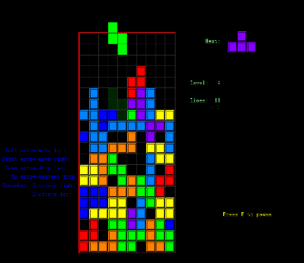
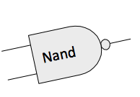

The expressive power of Nand
Theorem: Any Boolean function can be realized using only Nand.
Conclusion: Any computer can be built from Nand gates only:
Computers: Machines that realize Boolean functions:
f (input bits) = output bits
OK, so we can build a computer from Nand gates only.
But how can we actually do it?
That’s what the Nand to Tetris course is all about!

Slide 71
Chapter 1: Boolean logic
Theory
Basic concepts
Boolean algebra
Boolean functions
Nand
Practice
Logic gates
HDL
Hardware simulation
Multi-bit buses
Project 1
Introduction
Chips
Guidelines

Slide 72
Chapter 1: Boolean logic
Theory
Basic concepts
Boolean algebra
Boolean functions
Nand
Practice
Logic gates
HDL
Hardware simulation
Multi-bit buses
Project 1
Introduction
Chips
Guidelines

Slide 73
Logic gates
Elementary gates (Nand, And, Or, Not, …)
Composite gates (Mux, Adder, …)

Slide 74
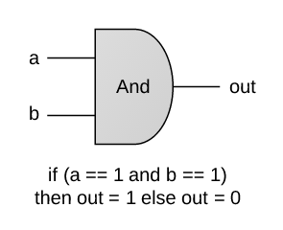
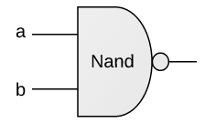
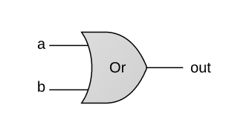
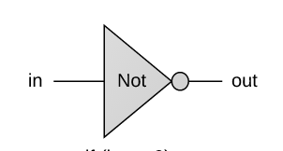
Elementary gates
And
if (a==1 and b==1)
then out=0 else out=1
if (a==1 and b==1)
then out=1 else out=0
if (a==1 or b==1)
then out=1 else out=0
if (in==0)
then out=1 else out=0
Why focus on these particular gates?
Because either {Nand} or {And, Or, Not} (as well as other subsets) can be used to span any given Boolean function
Because they have efficient hardware implementations.

Slide 75
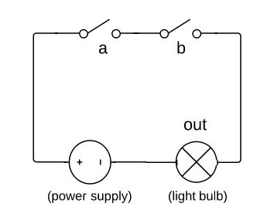
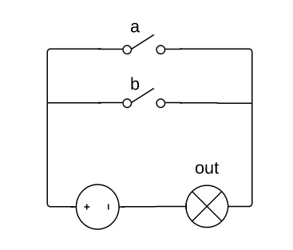
Elementary gates
And
if (a==1 and b==1)
then out=1 else out=0
if (a==1 or b==1)
then out=1 else out=0
Circuit implementations:
And circuit
Or circuit

Slide 76
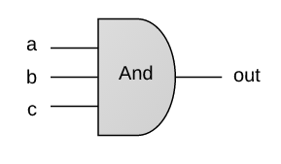
Composite gates
And3
if (a==1 and b==1 and c==1)
then out=1 else out=0

Slide 77
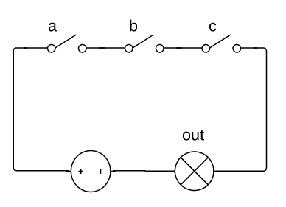
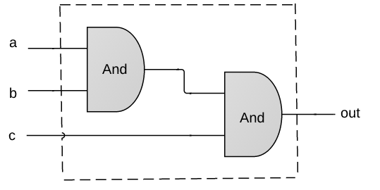
Composite gates
And3
if (a==1 and b==1 and c==1)
then out=1 else out=0
Possible implementations:
Physical
Logical
This course does not deal with physical implementations
(circuits, transistors, relays... that’s EE, not CS)
We focus only on logical implementations

Slide 78
Chapter 1: Boolean logic
Theory
Basic concepts
Boolean algebra
Boolean functions
Nand
Practice
Logic gates
HDL
Hardware simulation
Multi-bit buses
Project 1
Introduction
Chips
Guidelines

Slide 79
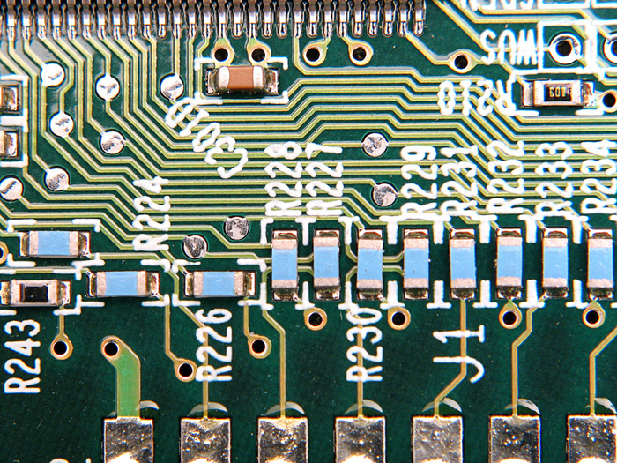
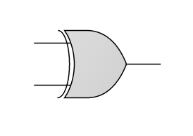
Building a chip
a
?
Xor
out
b
if ((a == 0 and b == 1) or (a == 1 and b == 0))
sets out = 1
else
sets out = 0
The process
Design the chip architecture
Specify the architecture in HDL
Test the chip in a hardware simulator
Optimize the design
Realize the optimized design in silicon.

Slide 80
Building a chip
a
?
Xor
out
b
if ((a == 0 and b == 1) or (a == 1 and b == 0))
sets out = 1
else
sets out = 0
The process
Design the chip architecture
Specify the architecture in HDL
Test the chip in a hardware simulator
Optimize the design
Realize the optimized design in silicon.

Slide 81
Design: Requirements
a
a | b | out
0 | 0 | 0
0 | 1 | 1
1 | 0 | 1
1 | 1 | 0
Requirement
Build a chip that delivers this functionality
Xor
out
b
if ((a == 0 and b == 1) or (a == 1 and b == 0))
sets out = 1
else
sets out = 1
/** Sets out = (a And Not(b)) Or (Not(a) And b)) */
CHIP Xor {
IN a, b;
OUT out;
PARTS:
// Missing implementation
Gate Interface
Expressed as an HDL stub file

Slide 82
Design: Implementation
/** Sets out = (a And Not(b)) Or (Not(a) And b)) */
CHIP Xor {
IN a, b;
OUT out;
PARTS:
// Missing implementation
Gate Interface
Expressed as an HDL stub file

Slide 83
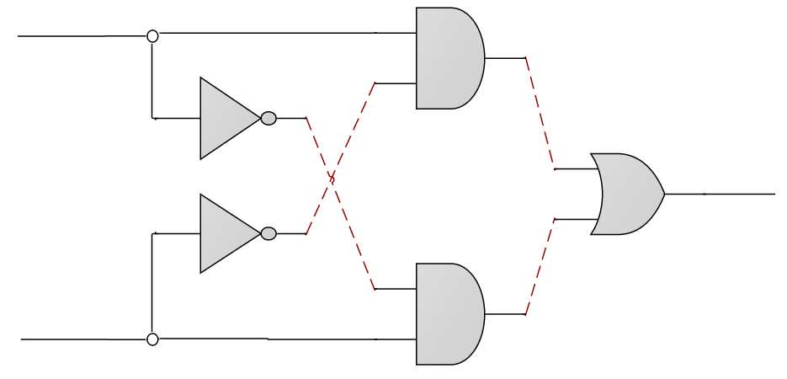
Design: Implementation
a
a
And
out
b
Gate diagram
in
Not
out
aAndNotb
notb
a
Or
out
out
b
in
Not
out
nota
a
notaAndb
And
out
b
b
/** Sets out = (a And Not(b)) Or (Not(a) And b)) */
CHIP Xor {
IN a, b;
OUT out;
PARTS:
// Missing implementation
Gate Interface
Expressed as an HDL stub file

Slide 84
Design: Implementation
a
a
And
out
b
Gate diagram
in
Not
out
aAndNotb
notb
a
Or
out
out
b
in
Not
out
nota
a
notaAndb
And
out
b
b
/** Sets out = (a And Not(b)) Or (Not(a) And b)) */
CHIP Xor {
IN a, b;
OUT out;
PARTS:
// Missing implementation
Gate Interface
Expressed as an HDL stub file

Slide 85
Design: Implementation
a
a
And
out
b
in
Not
out
aAndNotb
notb
a
Or
out
out
b
in
Not
out
nota
a
notaAndb
And
out
b
b
/** Sets out = (a And Not(b)) Or (Not(a) And b)) */
CHIP Xor {
IN a, b;
OUT out;
PARTS:
// Missing implementation

Slide 86
Design: Implementation
a
a
And
out
b
in
Not
out
aAndNotb
notb
a
Or
out
out
b
in
Not
out
nota
a
notaAndb
And
out
b
b
/** Sets out = (a And Not(b)) Or (Not(a) And b)) */
CHIP Xor {
IN a, b;
OUT out;
PARTS:
Not (in=a, out=nota);
Not (in=b, out=notb);
And (a=a, b=notb, out=aAndNotb);
And (a=nota, b=b, out=notaAndb);
}

Slide 87
Design: Implementation
a
a
And
out
b
in
Not
out
aAndNotb
notb
a
Or
out
out
b
in
Not
out
nota
a
notaAndb
And
out
b
b
/** Sets out = (a And Not(b)) Or (Not(a) And b)) */
CHIP Xor {
IN a, b;
OUT out;
PARTS:
Not (in=a, out=nota);
Not (in=b, out=notb);
And (a=a, b=notb, out=aAndNotb);
And (a=nota, b=b, out=notaAndb);
}
Practice: Complete the missing HDL code

Slide 88
Design: Implementation
a
a
And
out
b
in
Not
out
aAndNotb
notb
a
Or
out
out
b
in
Not
out
nota
a
notaAndb
And
out
b
b
/** Sets out = (a And Not(b)) Or (Not(a) And b)) */
CHIP Xor {
IN a, b;
OUT out;
PARTS:
Not (in=a, out=nota);
Not (in=b, out=notb);
And (a=a, b=notb, out=aAndNotb);
And (a=nota, b=b, out=notaAndb);
Or (a=aAndNotb, b=notaAndb, out=out);
}

Slide 89
Interface / Implementation
a
a
And
out
b
in
Not
out
aAndNotb
notb
a
Or
out
out
b
in
Not
out
nota
a
notaAndb
And
out
b
b
/** Sets out = (a And Not(b)) Or (Not(a) And b)) */
CHIP Xor {
IN a, b;
OUT out;
PARTS:
Not (in=a, out=nota);
Not (in=b, out=notb);
And (a=a, b=notb, out=aAndNotb);
And (a=nota, b=b, out=notaAndb);
Or (a=aAndNotb, b=notaAndb, out=out);
}
gate
interface
A logic gate has:
One interface
Many possible implementations
gate
Implement-ation

Slide 90
Hardware description languages
Observations:
HDL is a functional / declarative language
An HDL program can be viewed as a textual specification of a chip diagram
The order of HDL statements is insignificant.
/** Sets out = (a And Not(b)) Or (Not(a) And b)) */
CHIP Xor {
IN a, b;
OUT out;
PARTS:
Not (in=a, out=nota);
Not (in=b, out=notb);
And (a=a, b=notb, out=aAndNotb);
And (a=nota, b=b, out=notaAndb);
Or (a=aAndNotb, b=notaAndb, out=out);
}

Slide 91
Hardware description languages
Common HDLs
VHDL
Verilog
…
Our HDL
Similar in spirit to other HDLs
Minimal and simple
Provides all you need for this course
Our HDL Guide / Documentation:
The Elements of Computing Systems / Appendix 2: HDL
/** Sets out = (a And Not(b)) Or (Not(a) And b)) */
CHIP Xor {
IN a, b;
OUT out;
PARTS:
Not (in=a, out=nota);
Not (in=b, out=notb);
And (a=a, b=notb, out=aAndNotb);
And (a=nota, b=b, out=notaAndb);
Or (a=aAndNotb, b=notaAndb, out=out);
}

Slide 92
Chapter 1: Boolean logic
Theory
Basic concepts
Boolean algebra
Boolean functions
Nand
Practice
Logic gates
HDL
Hardware simulation
Multi-bit buses
Project 1
Introduction
Chips
Guidelines

Slide 93
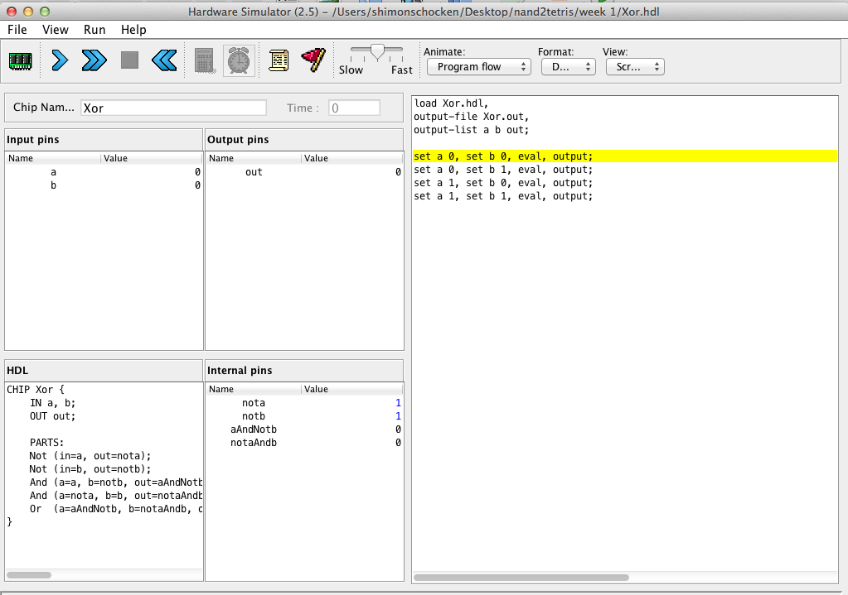
Hardware simulation in a nutshell
CHIP Xor {
IN a, b;
OUT out;
PARTS:
Not (in=a, out=nota);
Not (in=b, out=notb);
And (a=a, b=notb, out=aAndNotb);
And (a=nota, b=b, out=notaAndb);
Or (a=aAndNotb, b=notaAndb, out=out);
}
HDL code
simulate
hardware simulator
Simulation options
Interactive
Script-based.

Slide 94
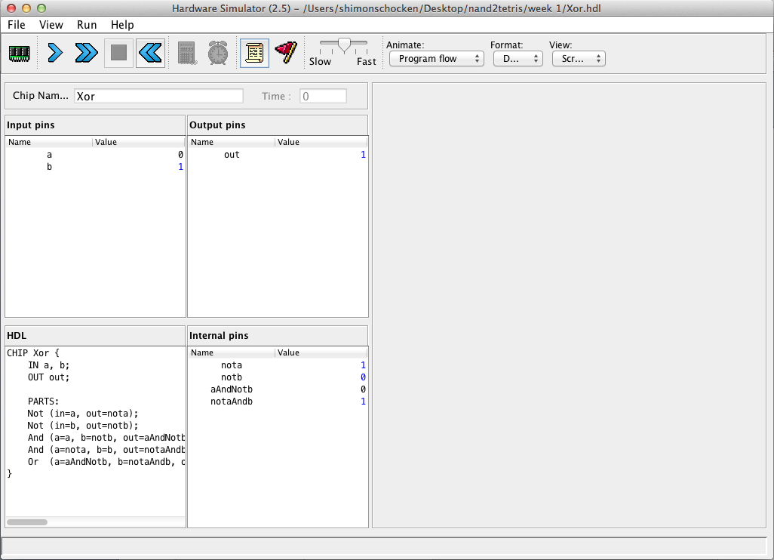
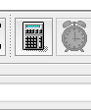
Interactive simulation
1. Load an HDL program

Slide 95
Interactive simulation
3. evaluate the chip logic
1. Load an HDL program
4. inspect output pins
2. manipulate
input pins
5. inspect internal pins
HDL code

Slide 96
Hardware simulation in a nutshell
CHIP Xor {
IN a, b;
OUT out;
PARTS:
Not (in=a, out=nota);
Not (in=b, out=notb);
And (a=a, b=notb, out=aAndNotb);
And (a=nota, b=b, out=notaAndb);
Or (a=aAndNotb, b=notaAndb, out=out);
}
HDL code
simulate
load Xor.hdl,
output-file And.out,
output-list a b out;
set a 0, set b 0, eval, output;
set a 0, set b 1, eval, output;
set a 1, set b 0, eval, output;
set a 1, set b 1, eval, output;
hardware simulator
test script
Simulation options
Interactive
Script-based.

Slide 97
Script-based simulation
Xor.hdl
Xor.tst
CHIP Xor {
IN a, b;
OUT out;
PARTS:
Not (in=a, out=nota);
Not (in=b, out=notb);
And (a=a, b=notb, out=aAndNotb);
And (a=nota, b=b, out=notaAndb);
Or (a=aAndNotb, b=notaAndb, out=out);
}
load Xor.hdl;
set a 0, set b 0, eval;
set a 0, set b 1, eval;
set a 1, set b 0, eval;
set a 1, set b 1, eval;
test script = sequence of commands to the simulator
Benefits:
“Automatic” testing
Replicable testing.

Slide 98
Script-based simulation, with an output file
Xor.hdl
Xor.tst
CHIP Xor {
IN a, b;
OUT out;
PARTS:
Not (in=a, out=nota);
Not (in=b, out=notb);
And (a=a, b=notb, out=aAndNotb);
And (a=nota, b=b, out=notaAndb);
Or (a=aAndNotb, b=notaAndb, out=out);
}
load Xor.hdl,
output-file Xor.out,
output-list a b out;
set a 0, set b 0, eval, output;
set a 0, set b 1, eval, output;
set a 1, set b 0, eval, output;
set a 1, set b 1, eval, output;
tested chip
Xor.out
test
script
The logic of a typical test script
Initialize:
Loads an HDL file
Creates an empty output file
Lists the names of the pins whose values will be written to the output file
Repeat:
set – eval - output
| a | b |out|
| 0 | 0 | 0 |
| 0 | 1 | 1 |
| 1 | 0 | 1 |
| 1 | 1 | 0 |
Output File, created by the test script, as a side-effect of the simulation process

Slide 99
Script-based simulation
1. Load a test script

Slide 100
Script-based simulation
2. run the script
1. Load a test script
test script

Slide 101
Script-based simulation
inspect the output file
2. run the script
1. Load a test script
test script
Xor.out
| a | b |out|
| 0 | 0 | 0 |
| 0 | 1 | 1 |
| 1 | 0 | 1 |
| 1 | 1 | 0 |
HDL code

Slide 102
Script-based simulation
Xor.hdl
Xor.tst
CHIP Xor {
IN a, b;
OUT out;
PARTS:
Not (in=a, out=nota);
Not (in=b, out=notb);
And (a=a, b=notb, out=aAndNotb);
And (a=nota, b=b, out=notaAndb);
Or (a=aAndNotb, b=notaAndb, out=out);
}
load Xor.hdl,
output-file Xor.out,
output-list a b out;
set a 0, set b 0, eval, output;
set a 0, set b 1, eval, output;
set a 1, set b 0, eval, output;
set a 1, set b 1, eval, output;
Xor.out
| a | b |out|
| 0 | 0 | 0 |
| 0 | 1 | 1 |
| 1 | 0 | 1 |
| 1 | 1 | 0 |

Slide 103
Script-based simulation, with a compare file
Xor.hdl
Xor.tst
CHIP Xor {
IN a, b;
OUT out;
PARTS:
Not (in=a, out=nota);
Not (in=b, out=notb);
And (a=a, b=notb, out=aAndNotb);
And (a=nota, b=b, out=notaAndb);
Or (a=aAndNotb, b=notaAndb, out=out);
}
load Xor.hdl,
output-file Xor.out,
compare-to Xor.cmp,
output-list a b out;
set a 0, set b 0, eval, output;
set a 0, set b 1, eval, output;
set a 1, set b 0, eval, output;
set a 1, set b 1, eval, output;
Xor.out
Xor.cmp
Simulation-with-compare-file logic
When each output command is executed, the outputted line is compared to the corresponding line in the compare file
If the two lines are not the same, the simulator throws a comparison error.
| a | b |out|
| 0 | 0 | 0 |
| 0 | 1 | 1 |
| 1 | 0 | 1 |
| 1 | 1 | 0 |
| a | b |out|
| 0 | 0 | 0 |
| 0 | 1 | 1 |
| 1 | 0 | 1 |
| 1 | 1 | 0 |
compare

Slide 104
Script-based simulation, with a compare file
Xor.hdl
Xor.tst
CHIP Xor {
IN a, b;
OUT out;
PARTS:
Not (in=a, out=nota);
Not (in=b, out=notb);
And (a=a, b=notb, out=aAndNotb);
And (a=nota, b=b, out=notaAndb);
Or (a=aAndNotb, b=notaAndb, out=out);
}
load Xor.hdl,
output-file Xor.out,
compare-to Xor.cmp,
output-list a b out;
set a 0, set b 0, eval, output;
set a 0, set b 1, eval, output;
set a 1, set b 0, eval, output;
set a 1, set b 1, eval, output;
Xor.out
Xor.cmp
Demos:
| a | b |out|
| 0 | 0 | 0 |
| 0 | 1 | 1 |
| 1 | 0 | 1 |
| 1 | 1 | 0 |
| a | b |out|
| 0 | 0 | 0 |
| 0 | 1 | 1 |
| 1 | 0 | 1 |
| 1 | 1 | 0 |
Experimenting with Built-In Chips
Building and Testing HDL-based Chips
Script-Based Chip Testing
compare

Slide 105
Chapter 1: Boolean logic
Theory
Basic concepts
Boolean algebra
Boolean functions
Nand
Practice
Logic gates
HDL
Hardware simulation
Multi-bit buses
Project 1
Introduction
Chips
Guidelines

Slide 106
Multi-bit bus
Sometimes we wish to manipulate a sequence of bits as a single entity
Such a multi-bit entity is termed “bus”
Example: 16-bit bus
15
14
13
12
11
10
9
8
7
6
5
4
3
2
1
0
1
0
0
0
1
0
0
0
1
1
0
1
1
1
0
1
MSB = Most significant bit
LSB = Least significant bit

Slide 107
Working with buses: Example
/* Adds two 16-bit values. */
CHIP Adder {
IN a[16], b[16];
OUT out[16];
PARTS:
...
}
/* Adds three 16-bit inputs. */
CHIP Adder3Way {
IN a[16], b[16], c[16];
OUT out[16];
15
. . .
1
0
a:
1
. . .
1
1
b:
0
. . .
1
0
c:
0
. . .
0
1
out:
1
. . .
1
0

Slide 108
Working with buses: Example
/* Adds two 16-bit values. */
CHIP Adder {
IN a[16], b[16];
OUT out[16];
PARTS:
...
}
/* Adds three 16-bit inputs. */
CHIP Adder3Way {
IN a[16], b[16], c[16];
OUT out[16];
PARTS:
Adder(a= , b= , out= );
Adder(a= , b= , out= );
}
15
. . .
1
0
a:
1
. . .
1
1
b:
0
. . .
1
0
c:
0
. . .
0
1
out:
1
. . .
1
0

Slide 109
Working with buses: Example
/* Adds two 16-bit values. */
CHIP Adder {
IN a[16], b[16];
OUT out[16];
PARTS:
...
}
/* Adds three 16-bit inputs. */
CHIP Adder3Way {
IN a[16], b[16], c[16];
OUT out[16];
PARTS:
Adder(a=a , b=b, out=ab);
Adder(a=ab, b=c, out=out);
}
15
. . .
1
0
n-bit value (bus) can be treated as a single entity
a:
1
. . .
1
1
b:
0
. . .
1
0
c:
0
. . .
0
1
Creates an internal bus pin (ab)
out:
1
. . .
1
0

Slide 110
Working with individual bits within buses
/* Returns 1 if a==1 and b==1,
* 0 otherwise. */
CHIP And {
IN a, b;
OUT out;
...
}
/* 4-way And: Ands 4 bits. */
CHIP And4Way {
IN a[4];
OUT out;
3
2
1
0
a:
0
1
1
1
out:
0

Slide 111
Working with individual bits within buses
/* Returns 1 if a==1 and b==1,
* 0 otherwise. */
CHIP And {
IN a, b;
OUT out;
...
}
/* 4-way And: Ands 4 bits. */
CHIP And4Way {
IN a[4];
OUT out;
PARTS:
And(a= , b= , out= );
And(a= , b= , out= );
And(a= , b= , out= );
}
3
2
1
0
a:
0
1
1
1
out:
0

Slide 112
Working with individual bits within buses
/* Returns 1 if a==1 and b==1,
* 0 otherwise. */
CHIP And {
IN a, b;
OUT out;
...
}
/* 4-way And: Ands 4 bits. */
CHIP And4Way {
IN a[4];
OUT out;
PARTS:
And(a=a[0], b=a[1], out=and01);
And(a=and01, b=a[2], out=and012);
And(a=and012, b=a[3], out=out);
}
Input bus pins can be subscripted.
3
2
1
0
a:
0
1
1
1
out:
0

Slide 113
Working with individual bits within buses
/* Returns 1 if a==1 and b==1,
* 0 otherwise. */
CHIP And {
IN a, b;
OUT out;
...
}
/* 4-way And: Ands 4 bits. */
CHIP And4Way {
IN a[4];
OUT out;
PARTS:
And(a=a[0], b=a[1], out=and01);
And(a=and01, b=a[2], out=and012);
And(a=and012, b=a[3], out=out);
}
Input bus pins can be subscripted.
3
2
1
0
a:
0
1
1
1
out:
0
3
2
1
0
/* Bit-wise And of two 4-bit inputs */
CHIP And4 {
IN a[4], b[4];
OUT out[4];
a:
0
1
0
1
b:
0
0
1
1
out:
0
0
0
1

Slide 114
Working with individual bits within buses
/* Returns 1 if a==1 and b==1,
* 0 otherwise. */
CHIP And {
IN a, b;
OUT out;
...
}
/* 4-way And: Ands 4 bits. */
CHIP And4Way {
IN a[4];
OUT out;
PARTS:
And(a=a[0], b=a[1], out=and01);
And(a=and01, b=a[2], out=and012);
And(a=and012, b=a[3], out=out);
}
Input bus pins can be subscripted.
3
2
1
0
a:
0
1
1
1
out:
0
3
2
1
0
/* Bit-wise And of two 4-bit inputs */
CHIP And4 {
IN a[4], b[4];
OUT out[4];
PARTS:
And(a= , b= , out= );
And(a= , b= , out= );
And(a= , b= , out=. );
And(a= , b= , out= );
}
a:
0
1
0
1
b:
0
0
1
1
out:
0
0
0
1

Slide 115
Working with individual bits within buses
/* Returns 1 if a==1 and b==1,
* 0 otherwise. */
CHIP And {
IN a, b;
OUT out;
...
}
/* 4-way And: Ands 4 bits. */
CHIP And4Way {
IN a[4];
OUT out;
PARTS:
And(a=a[0], b=a[1], out=and01);
And(a=and01, b=a[2], out=and012);
And(a=and012, b=a[3], out=out);
}
Input bus pins can be subscripted.
3
2
1
0
a:
0
1
1
1
out:
0
3
2
1
0
/* Bit-wise And of two 4-bit inputs */
CHIP And4 {
IN a[4], b[4];
OUT out[4];
PARTS:
And(a=a[0], b=b[0], out=out[0]);
And(a=a[1], b=b[1], out=out[1]);
And(a=a[2], b=b[2], out=out[2]);
And(a=a[3], b=b[3], out=out[3]);
}
a:
0
1
0
1
Output bus pins can be subscripted
b:
0
0
1
1
out:
0
0
0
1

Slide 116
Chapter 1: Boolean logic
Theory
Basic concepts
Boolean algebra
Boolean functions
Nand
Practice
Logic gates
HDL
Hardware simulation
Multi-bit buses
Project 1
Introduction
Chips
Guidelines

Slide 117
Chapter 1: Boolean logic
Theory
Basic concepts
Boolean algebra
Boolean functions
Nand
Practice
Logic gates
HDL
Hardware simulation
Multi-bit buses
Project 1
Introduction
Chips
Guidelines

Slide 118
Built-in chips
We provide built-in versions of the chips built in this course (in tools/builtInChips).
For example:
Xor.hdl
Xor.hdl
/** Sets out to a Xor b */
CHIP Xor {
IN a, b;
OUT out;
PARTS:
Not (in=a, out=nota);
Not (in=b, out=notb);
And (a=a, b=notb, out=aAndNotb);
And (a=nota, b=b, out=notaAndb);
Or (a=aAndNotb, b=notaAndb, out=out);
}
/** Sets out to a Xor b */
CHIP Xor {
IN a, b;
OUT out;
BUILTIN Xor;
// implemented by a Xor.java class.
}
Implemented in HDL
Implemented in Java
A built-in chip has the same interface as the regular chip, but a different implementation
Behavioral simulation
Before building a chip in HDL, one can implement the chip logic in a high-level language
Enables experimenting with / testing the chip abstraction before actually building it
Enables high-level planning and testing of hardware architectures.
Demo: Loading and testing a built-in chip in the hardrawe simulator

Slide 119

Hardware construction projects
Key players:
Architect:
Decides which chips are needed
Specifies the chips
Developers:
Build / test the chips
In Nand to Tetris:
The architect is the course instructor; the developers are the students
For each chip, the architect supplies:
Built-in chip
Chip API (skeletal HDL program = stub file)
Test script
Compare file
Given these resources, the developers (students) build the chips.

Slide 120
The developer’s view (of, say, a Xor gate)
Xor.hdl
Xor.tst
/** Sets out to a Xor b */
CHIP Xor {
IN a, b;
OUT out;
PARTS:
// Implementation missing
}
load Xor.hdl,
output-file Xor.out,
compare-to Xor.cmp
output-list a b out;
set a 0, set b 0, eval, output;
set a 0, set b 1, eval, output;
set a 1, set b 0, eval, output;
set a 1, set b 1, eval, output;
stub file
test script
compare file
Xor.cmp
These files specify:
The chip interface (.hdl)
How the chip is supposed to behave (.cmp)
How to test the chip (.tst)
| a | b |out|
| 0 | 0 | 0 |
| 0 | 1 | 1 |
| 1 | 0 | 1 |
| 1 | 1 | 0 |

Slide 121
The developer’s view (of, say, a Xor gate)
Xor.hdl
Xor.tst
/** Sets out to a Xor b */
CHIP Xor {
IN a, b;
OUT out;
PARTS:
// Implementation missing
}
load Xor.hdl,
output-file Xor.out,
compare-to Xor.cmp
output-list a b out;
set a 0, set b 0, eval, output;
set a 0, set b 1, eval, output;
set a 1, set b 0, eval, output;
set a 1, set b 1, eval, output;
stub file
test script
compare file
Xor.cmp
These files specify:
The chip interface (.hdl)
How the chip is supposed to behave (.cmp)
How to test the chip (.tst)
The developer’s task:
Implement the chip (complete the supplied .hdl file), using these resources.
| a | b |out|
| 0 | 0 | 0 |
| 0 | 1 | 1 |
| 1 | 0 | 1 |
| 1 | 1 | 0 |

Slide 122
Nand to Tetris Roadmap: Hardware
abstraction
machine language
assembler
p6
hardware platform
abstraction
Building a computer
computer
abstraction
Building chips
p4
ALU, RAM
abstraction
Building gates
p5
p2
elementary logic gates
Nand
p3
p1

Slide 123
Project 1
abstraction
machine language
assembler
p6
hardware platform
abstraction
Building a computer
computer
abstraction
Building chips
p4
ALU, RAM
abstraction
Building gates
p5
p2
elementary logic gates
Nand
p3
p1
Project 1
Build 15 elementary logic gates

Slide 124
Project 1
Given: Nand
Goal: Build the following gates:
Elementary logic gates
16-bit variants
Multi-way variants
Not
And
Or
Xor
Mux
DMux
Not16
And16
Or16
Mux16
Or8Way
Mux4Way16
Mux8Way16
DMux4Way
DMux8Way
Why these 15 particular gates?
Commonly used gates
Comprise all the elementary logic gates needed to build our computer.

Slide 125
Project 1
Given: Nand
Goal: Build the following gates:
Elementary logic gates
16-bit variants
Multi-way variants
Not
And
Or
Xor
Mux
DMux
Not16
And16
Or16
Mux16
Or8Way
Mux4Way16
Mux8Way16
DMux4Way
DMux8Way

Slide 126
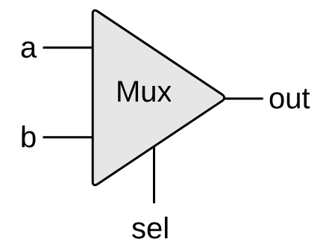
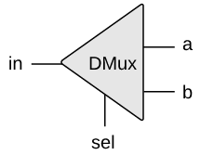
Multiplexor / Demultiplexor
if (sel == 0)
out = a
else
out = b
if (sel == 0)
{a, b} = {in, 0}
else
{a, b} = {0, in}
Widely used in:
Hardware design
Communications networks.

Slide 127
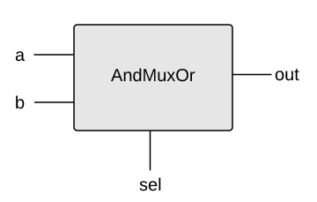
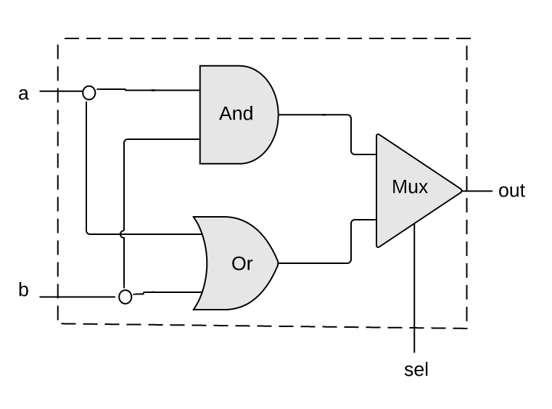
Example 1: Using Mux logic to build a programmable gate
a | b | sel | out
0 | 0 | 0 | 0
0 | 1 | 0 | 0
1 | 0 | 0 | 1
1 | 1 | 0 | 1
0 | 0 | 1 | 0
0 | 1 | 1 | 1
1 | 0 | 1 | 0
1 | 1 | 1 | 1
When sel == 0 the gate acts like an And gate
if (sel == 0)
out = a And b
else
out = a Or b
When sel == 1 the gate acts like an Or gate
Mux.hdl
CHIP AndMuxOr {
IN a, b, sel;
OUT out;

Slide 128
Example 1: Using Mux logic to build a programmable gate
a | b | sel | out
0 | 0 | 0 | 0
0 | 1 | 0 | 0
1 | 0 | 0 | 1
1 | 1 | 0 | 1
0 | 0 | 1 | 0
0 | 1 | 1 | 1
1 | 0 | 1 | 0
1 | 1 | 1 | 1
When sel == 0 the gate acts like an And gate
if (sel == 0)
out = a And b
else
out = a Or b
When sel == 1 the gate acts like an Or gate
Mux.hdl
CHIP AndMuxOr {
IN a, b, sel;
OUT out;
PARTS:
And (a=a, b=b, out=andOut);
Or (a=a, b=b, out=orOut);
Mux (a=andOut, b=orOut, sel=sel, out=out);
}

Slide 129
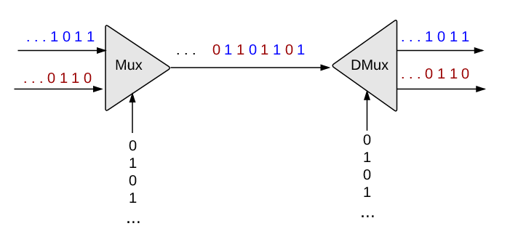
Example 2: Using Mux logic in communications networks
source
destination
The sel inputs feed from oscillators that produce alternating 0 and 1 signals
Enables transmitting multiple messages simultaneously using a single, shared communications line
Unrelated to this course.

Slide 130
Multiplexor
a | b | sel | out
0 | 0 | 0 | 0
0 | 1 | 0 | 0
1 | 0 | 0 | 1
1 | 1 | 0 | 1
0 | 0 | 1 | 0
0 | 1 | 1 | 1
1 | 0 | 1 | 0
1 | 1 | 1 | 1
sel | out
0 | a
1 | b
abbreviated truth table
if (sel == 0)
out = a
else
out = b
Mux.hdl
CHIP Mux {
IN a, b, sel;
OUT out;
PARTS:
// Put your code here:
}
Implementation tip
Can be implemented from the gates And, Or, Not.

Slide 131
Demultiplexor
in | sel | a | b
0 | 0 | 0 | 0
0 | 1 | 0 | 0
1 | 0 | 1 | 0
1 | 1 | 0 | 1
if (sel == 0)
{a, b} = {in, 0}
else
{a, b} = {0, in}
Acts like the “inverse” of a multiplexor
Channels the single input value into one of two possible destinations
DMux.hdl
CHIP DMux {
IN in, sel;
OUT a, b;
PARTS:
// Put your code here:
}
Implementation tip
Similar to the Mux implementation.

Slide 132
Project 1
Elementary logic gates
16-bit variants
Multi-way variants
Not
And
Or
Xor
Mux
DMux
Not16
And16
Or16
Mux16
Or8Way
Mux4Way16
Mux8Way16
DMux4Way
DMux8Way

Slide 133
Project 1
Elementary logic gates
16-bit variants
Multi-way variants
Not
And
Or
Xor
Mux
DMux
Not16
And16
Or16
Mux16
Or8Way
Mux4Way16
Mux8Way16
DMux4Way
DMux8Way

Slide 134
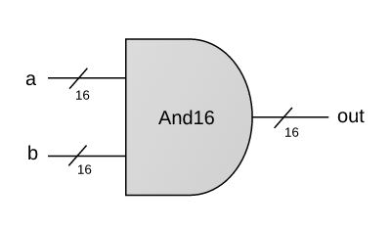
And16
Example:
a = 1 0 1 0 1 0 1 1 0 1 0 1 1 1 0 0
b = 0 0 1 0 1 1 0 1 0 0 1 0 1 0 1 0
out = 0 0 1 0 1 0 0 1 0 0 0 0 1 0 0 0
CHIP And16 {
IN a[16], b[16];
OUT out[16];
PARTS:
// Put your code here:
}
Implementation tip
A straightforward 16-bit extension of the elementary And gate
(See notes about working with multi-bit buses).

Slide 135
Project 1
Elementary logic gates
16-bit variants
Multi-way variants
Not
And
Or
Xor
Mux
DMux
Not16
And16
Or16
Mux16
Or8Way
Mux4Way16
Mux8Way16
DMux4Way
DMux8Way

Slide 136
Project 1
Elementary logic gates
16-bit variants
Multi-way variants
Not
And
Or
Xor
Mux
DMux
Not16
And16
Or16
Mux16
Or8Way
Mux4Way16
Mux8Way16
DMux4Way
DMux8Way

Slide 137
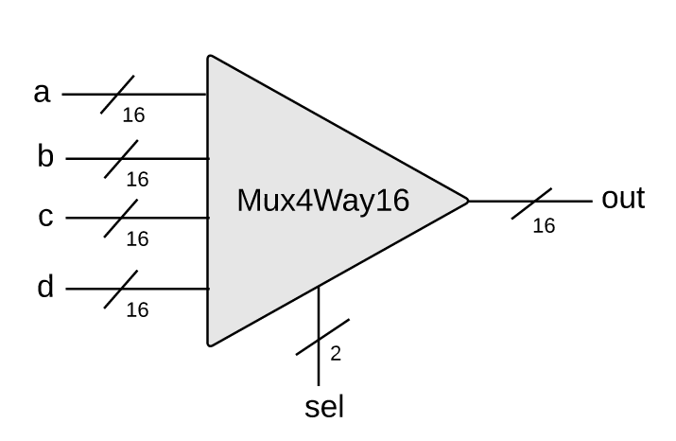
16-bit, 4-way multiplexor
sel[1] | sel[0] | out
0 | 0 | a
0 | 1 | b
1 | 0 | c
1 | 1 | d
Mux4Way16.hdl
CHIP Mux4Way16 {
IN a[16], b[16], c[16], d[16],
sel[2];
OUT out[16];
PARTS:
// Put your code here:
}
Implementation tip:
Can be built from several Mux16 gates.

Slide 138
Chapter 1: Boolean logic
Theory
Basic concepts
Boolean algebra
Boolean functions
Nand
Practice
Logic gates
HDL
Hardware simulation
Multi-bit buses
Project 1
Introduction
Chips
Guidelines

Slide 139

Project 1
Elementary logic gates
16-bit variants
Multi-way variants
Not
And
Or
Xor
Mux
DMux
Not16
And16
Or16
Mux16
Or8Way
Mux4Way16
Mux8Way16
DMux4Way
DMux8Way
How to actually build these gates?

Slide 140
Files
Xor.cmp
a
For every chip built in the course (using Xor as an example), we supply these three files
Xor
out
a b out
0 0 0
0 1 1
1 0 1
1 1 0
b
if ((a == 0 and b == 1) or (a == 1 and b == 0))
sets out = 1
else
sets out = 0
Xor.hdl (stub file)
Xor.tst
CHIP Xor {
IN a, b;
OUT out;
PARTS:
// Put your code here
}
load Xor.hdl,
output-file Xor.out,
compare-to Xor.cmp,
output-list a b out;
set a 0, set b 0, eval, output;
set a 0, set b 1, eval, output;
set a 1, set b 0, eval, output;
set a 1, set b 1, eval, output;

Slide 141
Files
Xor.cmp
The contract:
a
Xor
out
a b out
0 0 0
0 1 1
1 0 1
1 1 0
When running your Xor.hdl on the supplied Xor.tst, your Xor.out should be the same as the supplied Xor.cmp
b
if ((a == 0 and b == 1) or (a == 1 and b == 0))
sets out = 1
else
sets out = 0
Xor.hdl (stub file)
Xor.tst
Project 1 folder
(.hdl, .tst, .cmp files):
nand2tetris/projects/01
Tools:
Text editor (for completing the .hdl files)
Hardware simulator: nand2tetris/tools
CHIP Xor {
IN a, b;
OUT out;
PARTS:
// Put your code here
}
load Xor.hdl,
output-file Xor.out,
compare-to Xor.cmp,
output-list a b out;
set a 0, set b 0, eval, output;
set a 0, set b 1, eval, output;
set a 1, set b 0, eval, output;
set a 1, set b 1, eval, output;

Slide 142
Tools
Tools
Text editor (for completing the given .hdl stub-files)
Hardware simulator: nand2tetris/tools
Guides
Hardware Simulator Tutorial
HDL Guide

Slide 143
Guidelines: http://www.nand2tetris.org/project01
www.nand2tetris.org

Slide 144
Chip interfaces
a
a
And
out
b
in
Not
out
aAndNotb
notb
a
Or
out
out
b
in
Not
out
nota
a
notaAndb
And
out
b
b
CHIP Xor {
IN a, b;
OUT out;
PARTS:
Not (in= , out= );
Not (in= , out= );
And (a= , b=, out=);
And (a= , b=, out=);
Or (a= , b=, out=);
}
If I want to use some chip-parts, how do I figure out their signatures?

Slide 145
Chip interfaces: Hack chip set API
Open the Hack chip set API in a window, and copy-paste chip signatures into your HDL code, as needed
Add16 (a= ,b= ,out= );
ALU (x= ,y= ,zx= ,nx= ,zy= ,ny= ,f= ,no= ,out= ,zr= ,ng= );
And16 (a= ,b= ,out= );
And (a= ,b= ,out= );
Aregister (in= ,load= ,out= );
Bit (in= ,load= ,out= );
CPU (inM= ,instruction= ,reset= ,outM= ,writeM= ,addressM= ,pc= );
DFF (in= ,out= );
DMux4Way (in= ,sel= ,a= ,b= ,c= ,d= );
DMux8Way (in= ,sel= ,a= ,b= ,c= ,d= ,e= ,f= ,g= ,h= );
Dmux (in= ,sel= ,a= ,b= );
Dregister (in= ,load= ,out= );
FullAdder (a= ,b= ,c= ,sum= ,carry= );
HalfAdder (a= ,b= ,sum= , carry= );
Inc16 (in= ,out= );
Keyboard (out= );
Memory (in= ,load= ,address= ,out= );
Mux16 (a= ,b= ,sel= ,out= );
Mux4Way16 (a= ,b= ,c= ,d= ,sel= ,out= );
Mux8Way16 (a= ,b= ,c= ,d= ,e= ,f= ,g= ,h= ,sel= ,out= );
Mux8Way (a= ,b= ,c= ,d= ,e= ,f= ,g= ,h= ,sel= ,out= );
Mux (a= ,b= ,sel= ,out= );
Nand (a= ,b= ,out= );
Not16 (in= ,out= );
Not (in= ,out= );
Or16 (a= ,b= ,out= );
Or8Way (in= ,out= );
Or (a= ,b= ,out= );
PC (in= ,load= ,inc= ,reset= ,out= );
PCLoadLogic (cinstr= ,j1= ,j2= ,j3= ,load= ,inc= );
RAM16K (in= ,load= ,address= ,out= );
RAM4K (in= ,load= ,address= ,out= );
RAM512 (in= ,load= ,address= ,out= );
RAM64 (in= ,load= ,address= ,out= );
RAM8 (in= ,load= ,address= ,out= );
Register (in= ,load= ,out= );
ROM32K (address= ,out= );
Screen (in= ,load= ,address= ,out= );
Xor (a= ,b= ,out= );

Slide 146
Built-in chips
CHIP Foo {
IN ...;
OUT ...;
PARTS:
...
Bar(...)
...
}
Q: Suppose you want to use a chip-part before you’ve implemented it. How to do it?
A: The simulator features built-in implementations of all the project 1 chips
Forcing the simulator to use a built-in chip, say Bar:
Typically, Bar.hdl will be either a given stub-file, or a file that has an incomplete implementation
Remove, or rename, the file Bar.hdl from the project folder
Whenever Bar will be mentioned as a chip-part in some chip definition, the simulator will fail to find Bar.hdl in the current folder. This will cause the simulator to invoke the built-in version of Bar instead.

Slide 147
Best practice advice
Implement the chips in the order in which they appear in the project guidelines
If you don’t implement some chips, you can still use them as chip-parts in other chips (use their built-in implementations)
You can invent additional, “helper chips”; However, this is not necessary. Implement and use only the chips that we specified
In each chip definition, strive to use as few chip-parts as possible
When defining 16-bit chips, the same chip-parts may appear many times. That’s fine, use copy-paste-edit.
That’s It!
Go Do Project 1!

Slide 148
What’s next?
abstraction
machine language
assembler
p6
hardware platform
abstraction
Building a computer
computer
abstraction
Building chips
p4
ALU, RAM
abstraction
Building gates
p5
p2
elementary logic gates
Nand
p3
p1
This lecture / chapter / project:
Build 15 elementary logic gates

Slide 149
What’s next?
abstraction
machine language
assembler
p6
hardware platform
abstraction
Building a computer
computer
abstraction
Building chips
p4
ALU, RAM
abstraction
Building gates
p5
p2
elementary logic gates
Nand
p3
p1
Next lecture / chapter / project:
Build chips designed to do arithmetic, using the chips built in project 1

